Slide 1







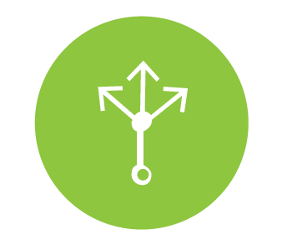



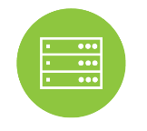





MICROSERVICES DEMO ARCHITECTURE
Accounts Overview Demo Application WITHIN THE SAME CLOUD
CLIENT
CLOUD SERVICE PROVIDER 1
ON PREMISES / CONTAINER / VM
BLUEMIX
Single Sign On
User Directory
Authentication Service
Log [ELK Stack]
Circuit Breaker Dashboard
[Hystrix Dashboard]
Monitoring Services
Monitoring Services
Desktop
[Internet Browsers]
Accounts Overview
Web
API Gateway
[Zuul]
Service
Choreographer
[Feign Client]
Circuit Breaker [Hystrix]
Service Lookup &
Load Balance
[Ribbon]
Service Registry &
Discovery [Eureka]
Configuration
Lookup
[Spring Config]
Mobile
[SWIFT Client]
Micro-Service Platform Services
CSP 2
SCM [GitHub]
Accounts
Micro-service
Accounts
[SQL DB]
Customers
Micro-service
Customers
[Cloudant DB]
Accounts Service
Customers Service
Microservices
Configurations
DEVOPS
Microservices
Source Code
Build
Test
Package & Deploy
Pipeline Service

Slide 2


MICROSERVICES DEMO ARCHITECTURE
Accounts Overview Demo Application IN HYBRID MODE
CLIENT
CLOUD SERVICE PROVIDER 1
ON PREMISES / CONTAINER / VM
BLUEMIX
Single Sign On
Authentication Service
Log [ELK Stack]
Circuit Breaker Dashboard
[Hystrix Dashboard]
VPN Service
VPN Client
Monitoring Services
Secure Connectivity
Desktop
[Internet Browsers]
Accounts Overview
Web
Service
Choreographer
[Feign Client]
Circuit Breaker [Hystrix]
Service Registry &
Discovery [Eureka]
Configuration
Lookup
[Spring Config]
Users
Micro-service
User
Directory
API Gateway
[Zuul]
Service Lookup &
Load Balance
[Ribbon]
Mobile
[SWIFT Client]
Micro-Service Platform Services
Users Service
CSP 2
SCM [GitHub]
Customers
Micro-service
Customers
[Cloudant DB]
Secure Gateway Service
Secure Client
Customers Service
Secure Connectivity
Microservices
Configurations
DEVOPS
Accounts
Micro-service
Accounts
[SQL DB]
Microservices
Source Code
Build
Test
Package & Deploy
Accounts Service
Pipeline Service

